Slide 1
Department of Computer Science & Engineering, BRAC University
ADVISOR
STUDENT
Annajiat Alim Rasel
Name: Mahmudul Hasan
ID: 20101168
Paper
Presentation
Facilitated Deep Learning Models for Image Captioning
Published in: 2021 55th Annual Conference on Information Sciences and Systems (CISS)
Publisher: IEEE
Date Added to IEEE Xplore: 19 April 2021
1

Slide 2

I
Research Background & Motivation
This paper focuses on developing semantic image caption generation techniques that leverage image and scene understanding
This task can help in a number of practical applications, including search engine optimization, or image retrieval tasks, among others
Although many studies have been presented recently to address these challenges, there is still lack in producing highly semantic captions that closely and accurately describe the image content
2

Slide 3
II RELATED WORK
Deep Learning Approaches
The survey conducted by Zhong titled “Object detection with deep learning: A review,” shows the importance of object detection in understanding image content and in extracting descriptive semantics of an image.
A study carried out named “Exploring visual relationship for image captioning,” in European Conference on Computer Vision, explores the relationship between objects and image captioning.
An Encoder-Decoder architecture is inspired by the machine translation model proposed by Sutskever in Proceedings of the 27th International Conference on Neural Information Processing Systems
Language Models: RNN / LSTM / Others
RNN is used in many sequence learning tasks such as “A comprehensive survey of deep learning for image captioning,” in ACM Computing Surveys
Vinyals used the LSTM as a decoder for the encoded image to generate the caption titled “Show and tell: A neural image caption generator,” in Proceedings of the IEEE conference on computer vision and pattern recognition
A recent approach proposed an enhanced LSTM architecture that considers the semantic roles of words towards a better sentence modeling
3

Slide 4


III
Methodology
Method
A facilitated captioning model that leverages the power of object detectors in cohesion with predefined heuristics
The entire system is a composition of multiple subsystems, each responsible for its own set of tasks
CNN, LSTM, Attention-enriched language models
Collected Sample
COCO and Flickr30k datasets
4

Slide 5
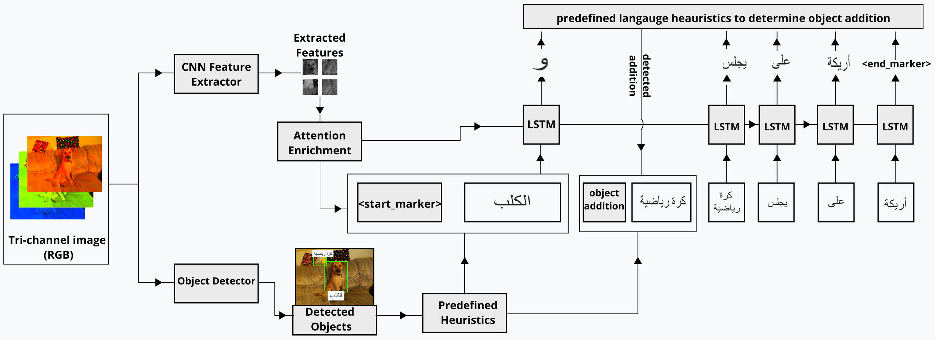
III
Methodology
Fig. 1. Object-based, attention-enriched captioning architecture
5

Slide 6

IV
MODEL ARCHITECTURE AND TRAINING
Pretrained Feature Extractor
Object Detection: Architecture and training
Captioning Language Model: Architecture and training of the language model
Algorithm 1 Caption generation process:
1: caption = [ ]
2: img = preprocess(img)
3: features = featureExtractor(img).output
4: objects = objectDetector(img).output
5: prediction = indexOf(startM arker)
6: while prediction 6= indexOf(endM arker) do
7: caption.add(wordOf(prediction))
8: caption = addObjects(caption, objects) 1
9: prediction = predictNextWord(features, caption)
10: end while
11: caption = caption.joinWith(0 0)
12: caption.remove(wordOf(startM arker), ifExists)
13: return caption
6

Slide 7
V
STAGGERING STAGES: END-TO-END CAPTIONING
The stages are then staggered to create an end to end pipeline for caption generation
Caption Generation: This section details the workings of the pseudo-code presented in Algorithm 1. The algorithm expects an image as its input of size (w, h, 3) and outputs a caption that represents contents of the input image.
Caption Generation with Attention Enrichment: Attention mechanisms traditionally help by allowing neural networks to focus on certain regions of an image, as opposed to the entire image itself
7

Slide 8
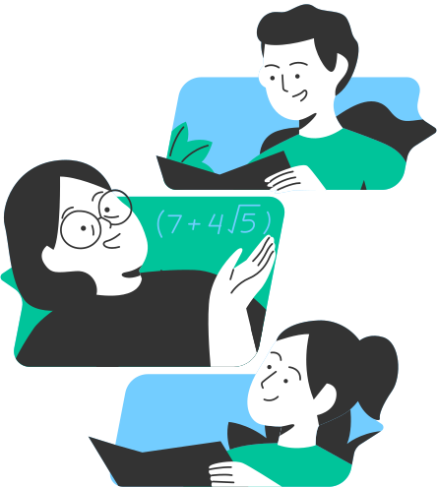
VI
Research Results
EVALUATION OF THE PROPOSED METHODOLOGY
This effective model can improve captioning performance using object detection and attention enrichment for facilitated generation. To actually determine if our facilitated networks give better performance in comparison to their original counterparts, an evaluation pipeline is set up.
Computing Similarity: Cosine similarity
Scoring the results
Evaluation datasets and results
8

Slide 9
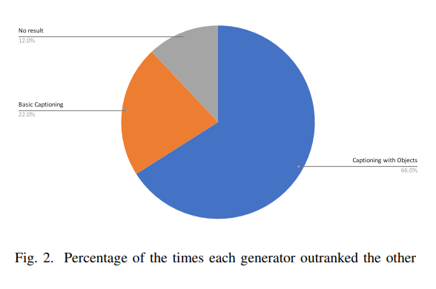
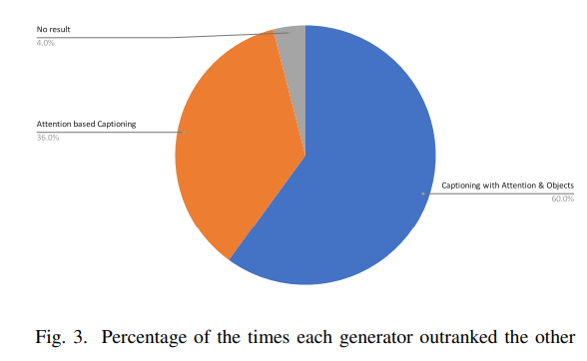
VI
Research Results
Pie Chart
Pie Chart
9

Slide 10
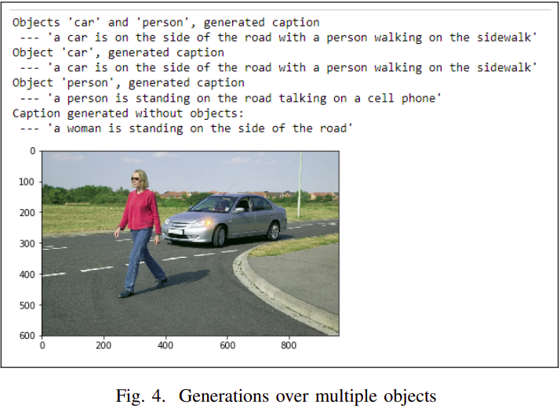
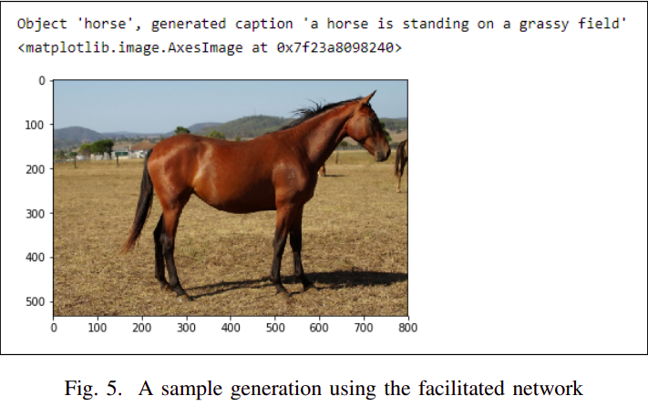
VI
Research Results
10

Slide 11



VII
Conclusion & Discussions
The paper presented the design and implementation of three deep learning models for facilitated image captioning
Results of the different models were evaluated using a semantic similarity analysis between the generated captions and the actual ground truth captions
In the future further experiments can be run with a various number of changes, which include using larger captioning datasets, using different architectures for the generative language models
11

Slide 12
Department of Computer Science & Engineering, BRAC University
ADVISOR
STUDENT
Annajiat Alim Rasel
Name: Mahmudul Hasan ID: 20101168
Thank you
for listening!
12

